Slide 1
Pemotongan Graf dengan Teknik Vertex Cut
Kevin Jonathan - 2014730020

Slide 2
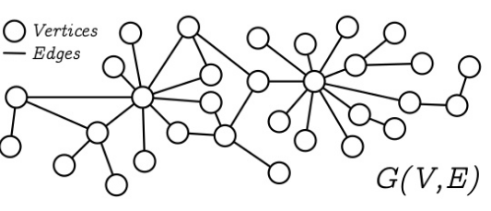
Sekilas Mengenai Graf
Sebuah graf adalah himpunan dari objek-objek yang dinamakan titik atau simpul (Vertex), dihubungkan oleh penghubung yang dinamakan garis atau sisi(Egde).

Slide 3
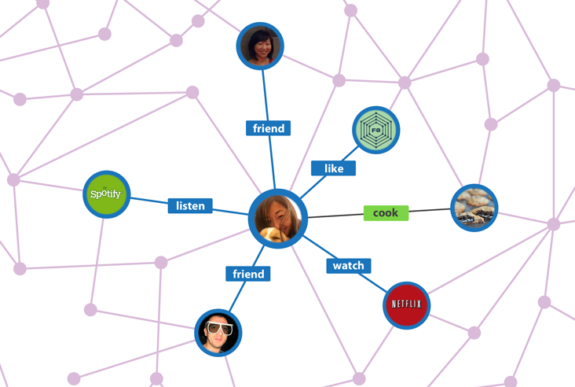
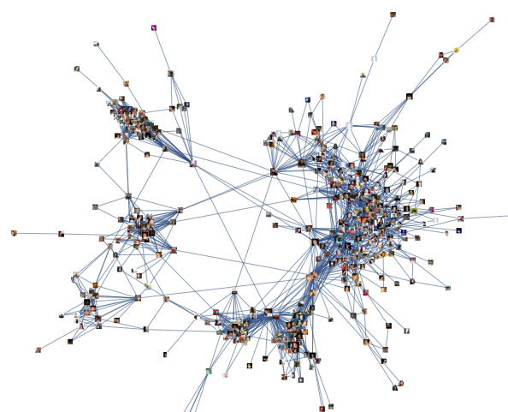
Sekilas Mengenai Graf
Graf dapat digunakan untuk memodelkan data yang besar dari data web, hubungan jejaring sosial, individu, peta konsep, dll.

Slide 4
Terminologi yang digunakan
Cuts
Pre cut
Separator
C separates A and B
k-inseparable
isolated corner
Slice
Block

Slide 5
Cuts & Pre-Cuts
Cuts : Let C be a collection of non-empty connected sets of vertices with finite boundaries in a connected graph. We call C a cut system if (C^*)^* = C for all C ∈ C and any pair C, D of elements of C satisfy the following.
Pre Cuts : If C is a cut-system then elements of C ∪ C^* are called pre-cuts.

Slide 6
Separator & C separates A and B
Separator : If C is a cut system then the boundary of a cut is called a separator
C separates A and B :We say that a cut C separates a set A from a set B if A ⊂ C ∪ NC and B ⊂ C^* ∪ NC or B ⊂ C ∪ NC and A ⊂ C∗ ∪ NC. Here we also require that neither A nor B is a subset of NC. A separator S is said to separate A from B if for some cut C with NC = S, C separates A and B.

Slide 7
k-inseparable & isolated corner
K-inseparable : Let k be a positive integer. A subset Y of V X is said to be k-inseparable if it has at least k + 1 elements and if for every set C ⊂ V X with|NC| ≤ k, either Y ⊂ C ∪ NC or Y ⊂ C∗ ∪ NC.
Isolated corner : A corner of two sets of vertices is called isolated if it does not contain a cut and if its adjacent links are both empty.

Slide 8
Slice & Block
Slice : We define a slice (or C-slice) to be a component of V X \ S that is not a cut, where S is a separator.
Block : A maximal C-inseparable set which is disjoint with all slices is called a C-block.

Slide 9

Rancangan Algoritma Vertex Cut

Slide 10
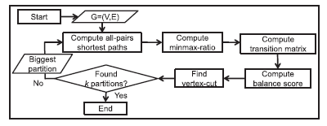
Flow Charts Algoritma Vertex Cut

Slide 11
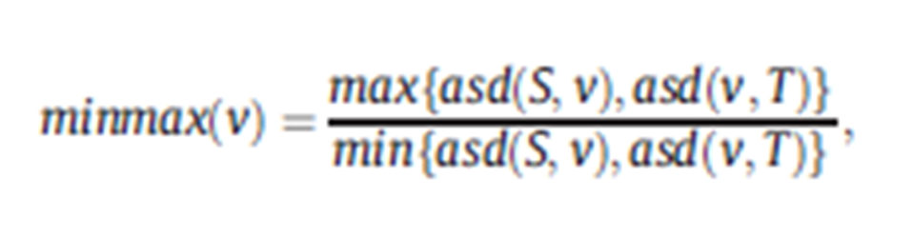
Minmax-ratios of the vertices
Dimana asd (S, v) adalah jarak jalur terpendek rata-rata dari simpul S ke v dan asd (v, T) adalah jalur terpendek rata-rata dari v ke simpul T.

Slide 12


Minmax-ratios of the vertices

Slide 13

Transition probabilities
Dimana entri mij mewakili probabilitas transisi dari vertex vi ke vj. Sedangkan (vj) menjadi himpunan tetangga vj begitu pula dengan (vi)

Slide 14
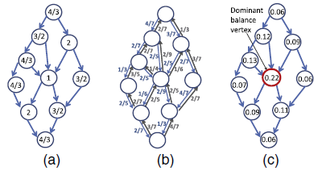
Obtaining the balance scores
Untuk mendapatkan balance score maka kita perlu melihat dari hasil – hasil Transisition Probalities. Balance score dapat ditemukan ketika ada nilai dari perhitungan Transisition Probalities yang mendekati angka 1
.

Slide 15
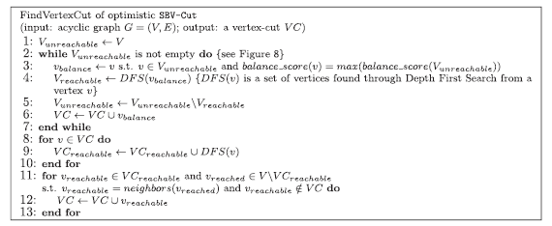
Find Vertex Cut

Slide 16

A Good Vertex Cut Partitioning

Slide 17
Sekian
Terima Kasih

